Slide 1

Presented By :- Sarthak Salvi

Slide 2



PROJECT Overview
To visualize employee data for strategic HR decision-making.
To identify trends in age, income, job roles, and gender distribution.
To support workforce planning through data-driven insights.

Slide 3
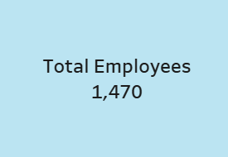
Total Employees
Purpose :-
Displays the total number of employees in the dataset.
Insight :-
The company workforce includes 1,470 employees, providing a substantial dataset for HR analysis.

Slide 4
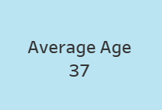
Average Age
Purpose :-
Shows the average age of employees.
Insight :-
The average age is around 37 years. This means most people are in their mid-working years, not freshers or close to retirement.

Slide 5
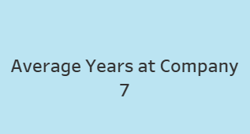
Average Years at Company
Purpose :-
Average tenure of employees.
Insight :-
Average tenure is 7 years, with higher values in R&D
and HR roles.

Slide 6
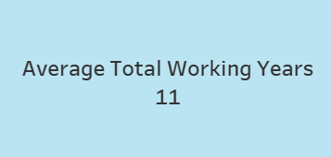
Average Total Working Years
Purpose :-
Employees have an average of 11 years of total work experience.
Insight :-
The workforce is experienced and likely in mid-to-senior roles.
Useful for project leadership, mentorship, and planning advanced training.

Slide 7
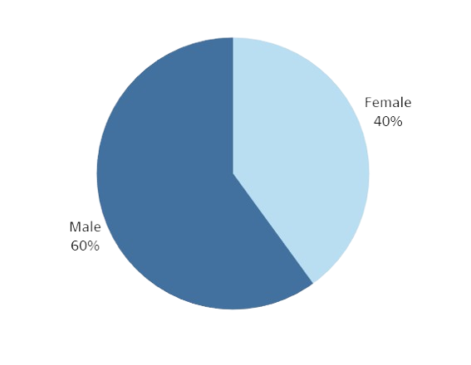
Genderwise Distribution
Purpose :-
Shows percentage split between male and female employees.
Insight :-
There is a higher percentage of male employees, indicating a gender imbalance. Certain departments like Technical or Sales have fewer female staff, suggesting opportunities for diversity improvements.

Slide 8
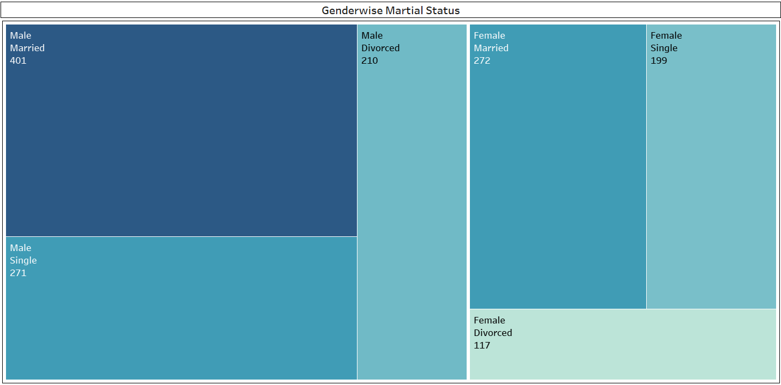
Genderwise Marital Status
Purpose :-
Visualizes how marital status varies by gender.
Insight :-
A higher number of married males compared to females. Useful for understanding personal demographics that can impact benefits and HR policies.

Slide 9
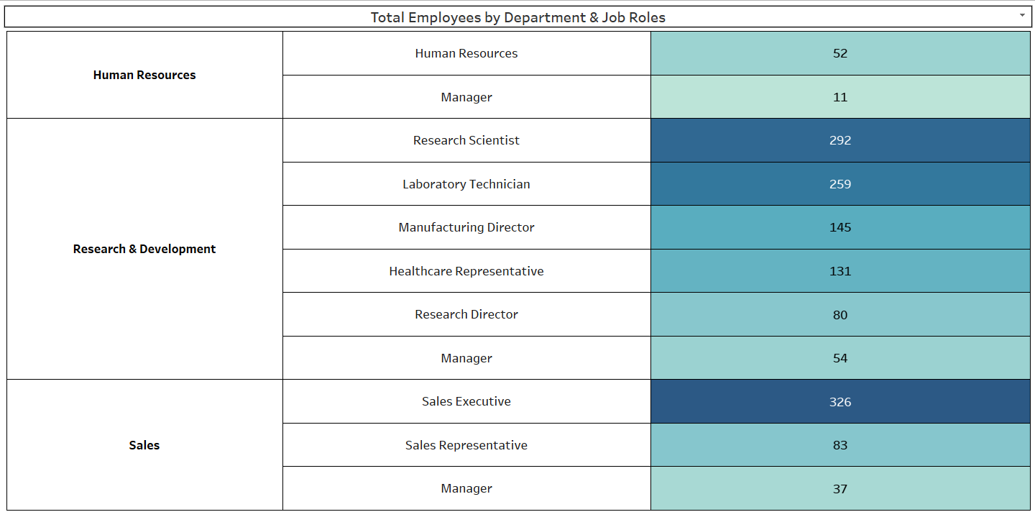
Total Employees by Department & Job Roles
Purpose :-
Displays count of employees categorized by department and their specific roles
Insight :-
Departments like Research & Development and Sales have the highest number of employees, while HR and Legal have fewer staff, showing where organizational manpower is concentrated.

Slide 10
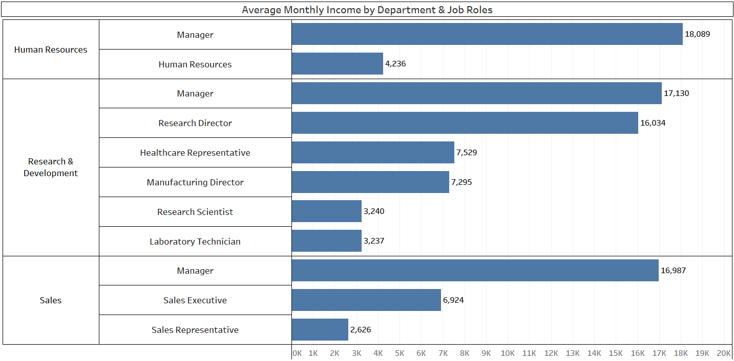
Average Monthly Income by Department & Job Roles
Purpose :-
Visualizes the average monthly salary across different roles within each department.
Insights :-
Managers and Research Directors are the highest earners.
Sales Executives have lower average salaries, but the department has a high number of employees, potential area for salary standardization.
HR role have modest salaries, suggesting scope for compensation review.

Slide 11
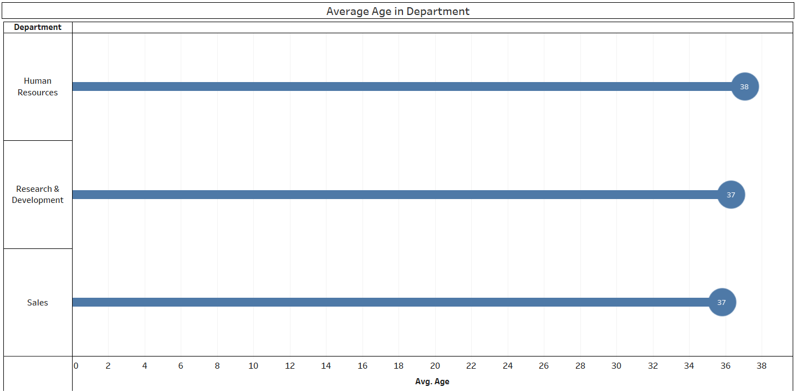
Average Age by Department
Purpose :-
To show the average age of employees across different departments.
Helps analyze workforce age distribution for planning and HR decisions.
Insights :-
Human Resources has the highest average age (38 years).
Sales and R&D have the same average age (37 years).
Minimal age gap (only 1 year), indicating uniform age distribution across departments.

Slide 12
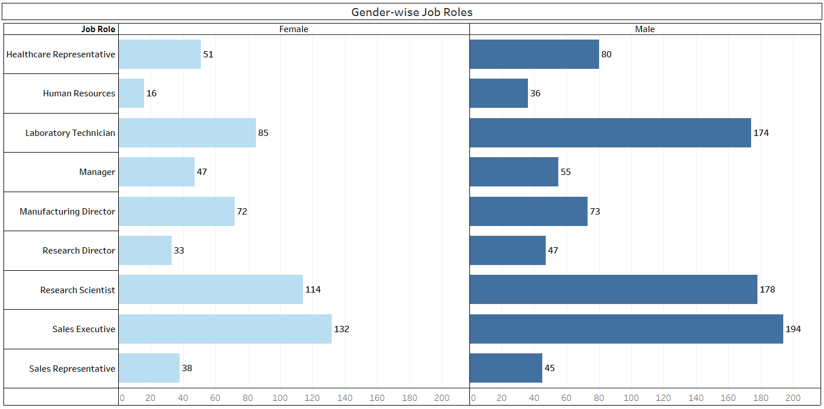
GENDERWISE JOB ROLES
Purpose :-
To visualize the distribution of male and female employees across job roles.
Helps understand gender diversity in various roles within the organization.
Insights :-
Sales Executive has the highest male (194) and female (132) count a dominant role across both genders.
Research Scientist has a strong presence from both genders: 178 males, 114 females.
Mostly Human Resources is female-dominated (16 females vs. 36 males), though overall count is low.
Laboratory Technician and Manufacturing Director roles have good female representation. (i.e. 85 and 72)
Research Director and Sales Representative have low female counts, suggesting possible scope for improvement in gender balance.

Slide 13
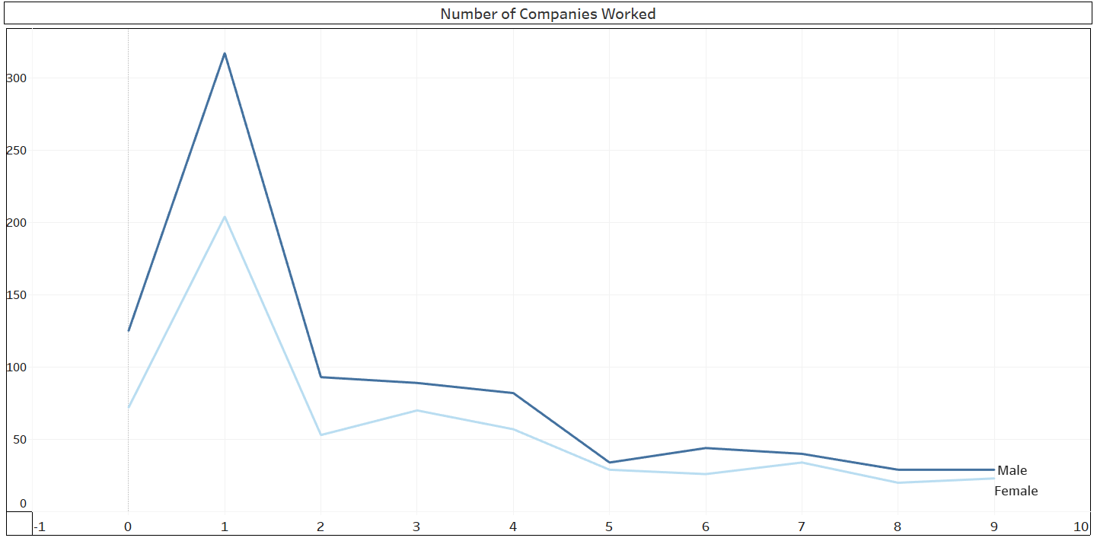
Number of Companies Worked
Purpose :-
Shows how many companies an employee has worked at before IBM.
Insights :-
Most employees have worked at 1–3 companies previously, indicating a workforce that’s moderately stable but still shows job-switching behavior

Slide 14
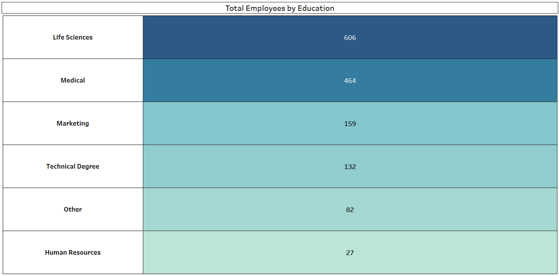
Total Employees by Education
Breakdown of employees based on education level (Bachelor, Master, PhD, etc.)
Purpose :-
To show the breakdown of employees based on education level.
Insights :-
Most employees hold a Bachelor’s or Masters
degree.
Very few employees have below Bachelor’s, indicating highly qualified workforce.
Useful for training investment decisions.

Slide 15
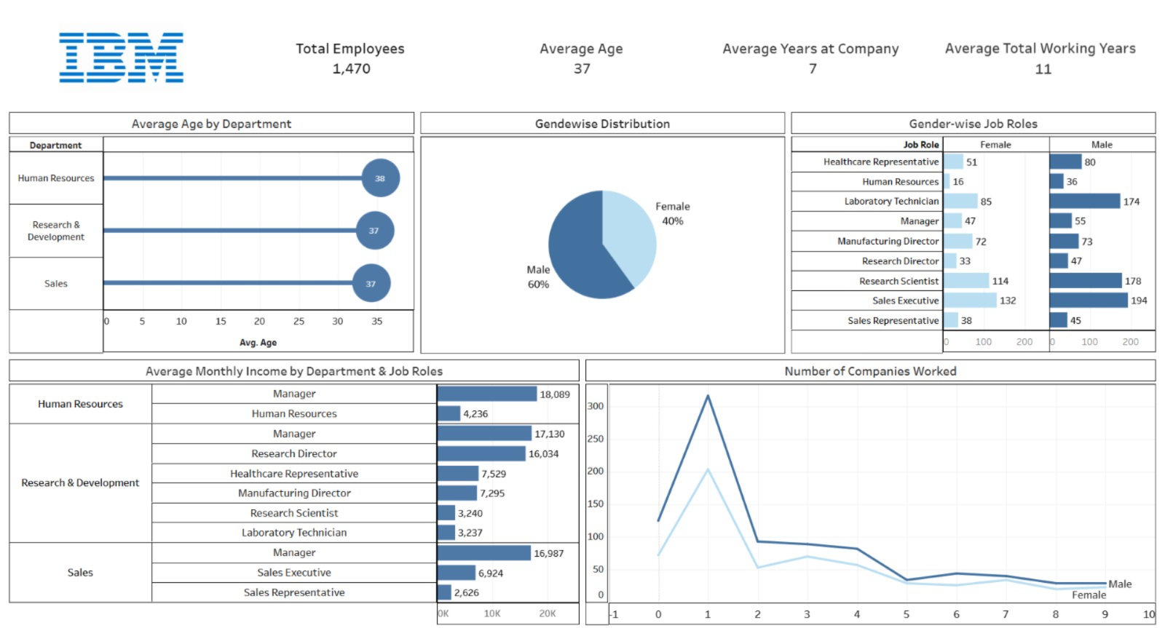
IBM HR DATA ANALYTICS DASHBOARD
Breakdown of employees based on education level (Bachelor, Master, PhD, etc.)

Slide 16
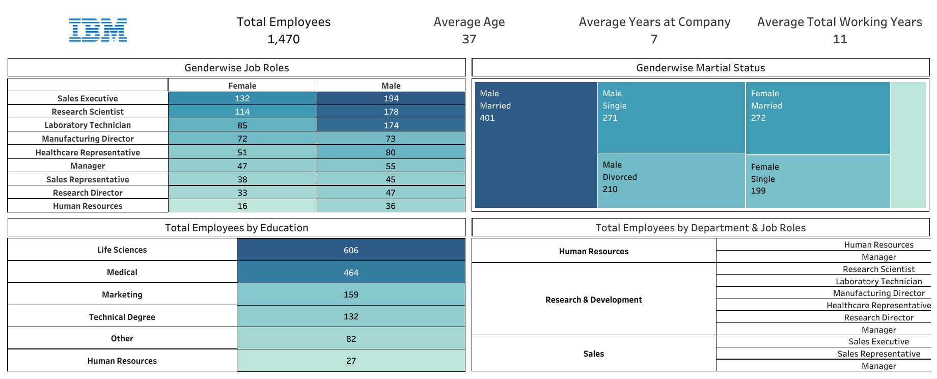
IBM HR DATA ANALYTICS REPORT
Breakdown of employees based on education level (Bachelor, Master, PhD, etc.)

Slide 17
Key Insights & Strategic Implications
Overall key insights
Strategic Implications
1) Average Total Working Years: 11.28
→ Employees are highly experienced.
2) Gender Distribution: More Males than Females
→ Company lacks gender balance.
3) Average Monthly Income Varies by Role
→ Managers earn much more than junior roles.
1) Utilize Experience for Leadership & Mentorship
→ Assign senior employees to train or guide others.
2) Promote Gender Diversity in Hiring
→ Focus on balanced recruitment across all departments.
3) Review Salary Structure for Fairness
→ Ensure pay equity and reduce dissatisfaction.

Slide 18
Conclusion
The company has a skilled and experienced workforce with over 11 years of average total experience.
Most employees are in their mid-career stage, making them suitable for leadership and key roles.
Gender imbalance exists, showing a need for more inclusive hiring practices.
Income varies widely by role, suggesting a review of salary fairness is needed.
Employees stay an average of 7 years, indicating good retention but with room for improvement.

Slide 19

☺

